Slide 1
Blood borne Pathogens
Any organism (bacteria, virus, etc..) that can cause disease is a pathogen. Blood-borne pathogens are those found in blood itself as well as on blood-soiled bandages, needles and other items that contain blood.
If a person comes in contact with blood infected with a blood borne pathogen, he or she may become infected.

Slide 2
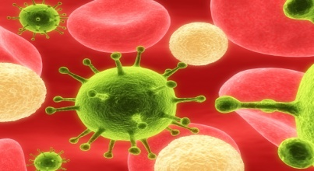
Hepatitis B virus (HBV) Human Immunodeficiency virus (HIV)
Hepatitis B (HBV)
Human Immunodeficiency Virus (HIV)
Causes inflammation of the liver
Can severely damage the liver and lead to cirrhosis
may have flu like symptoms (which can become very severe)
may have no symptoms at all and be unaware that they are infected
attacks the body’s immune system, leaving you susceptible to disease and infection
Symptoms of HIV infection include flu-like symptoms, fever, diarrhea and fatigue
A person can be infected with HIV and have no symptoms
eventually develop Acquired Immune Deficiency Syndrome (AIDS)
There are treatments for AIDS but no cure at the present time.

Slide 3
Transmission
Exposure to contaminated blood can occur through:
blood transfusion
needle stick with a contaminated needle
direct contact with contaminated blood through an open area on your skin
These viruses are spread through:
sexual activity
contact with contaminated blood

Slide 4
Universal Precautions
Assume that all blood and body fluid could be a source of infectious disease. When working with blood or other body fluids, steps are taken to protect yourself from exposure to infection.
These steps include:
Never touch blood or body fluids if you do not have to
Wearing gloves
Hand washing
Cleaning contaminated surfaces with an appropriate solution (one part bleach to 10 parts water). School custodial staff will take care of this for you.
Proper disposal of contaminated materials
Cover any cuts/open skin with band aids
Obtain Hepatitis B vaccine
Report any exposure immediately

Slide 5
Procedures to follow if an exposure incident occurs
If there is an exposure, wash the exposed area immediately
contact the school nurse.
Where to seek medical evaluation & treatment
Local city or county health department
Private physician
Local hospital emergency room

